Slide 1
Non-Steady State Corrosion by CO₂
David Young
Lesson 3 Class 1
School of Materials Science & Engineering
University of New South Wales
Sydney, Australia

Slide 2
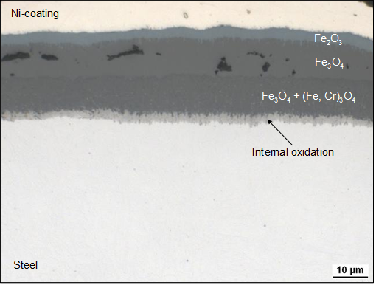
Reaction Morphology Ferritic-Martensitic Steels
P92, Ar-50%CO₂ for 150h

Slide 3
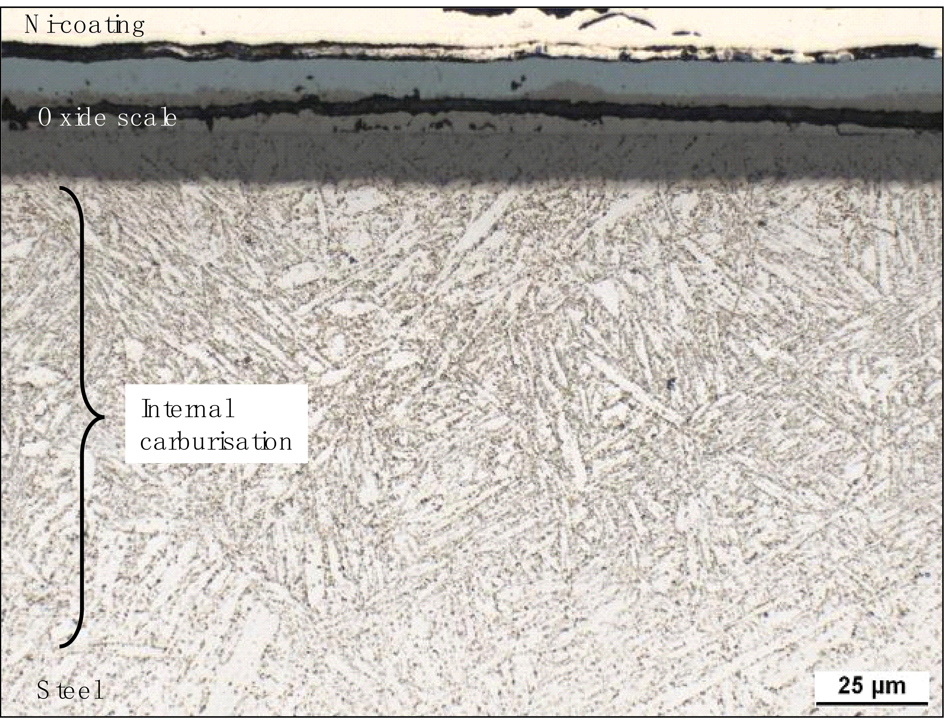
Reaction Morphology Ferritic-Martensitic Steels
P92, Ar-50%CO₂ for 150h, 550ºC

Slide 4
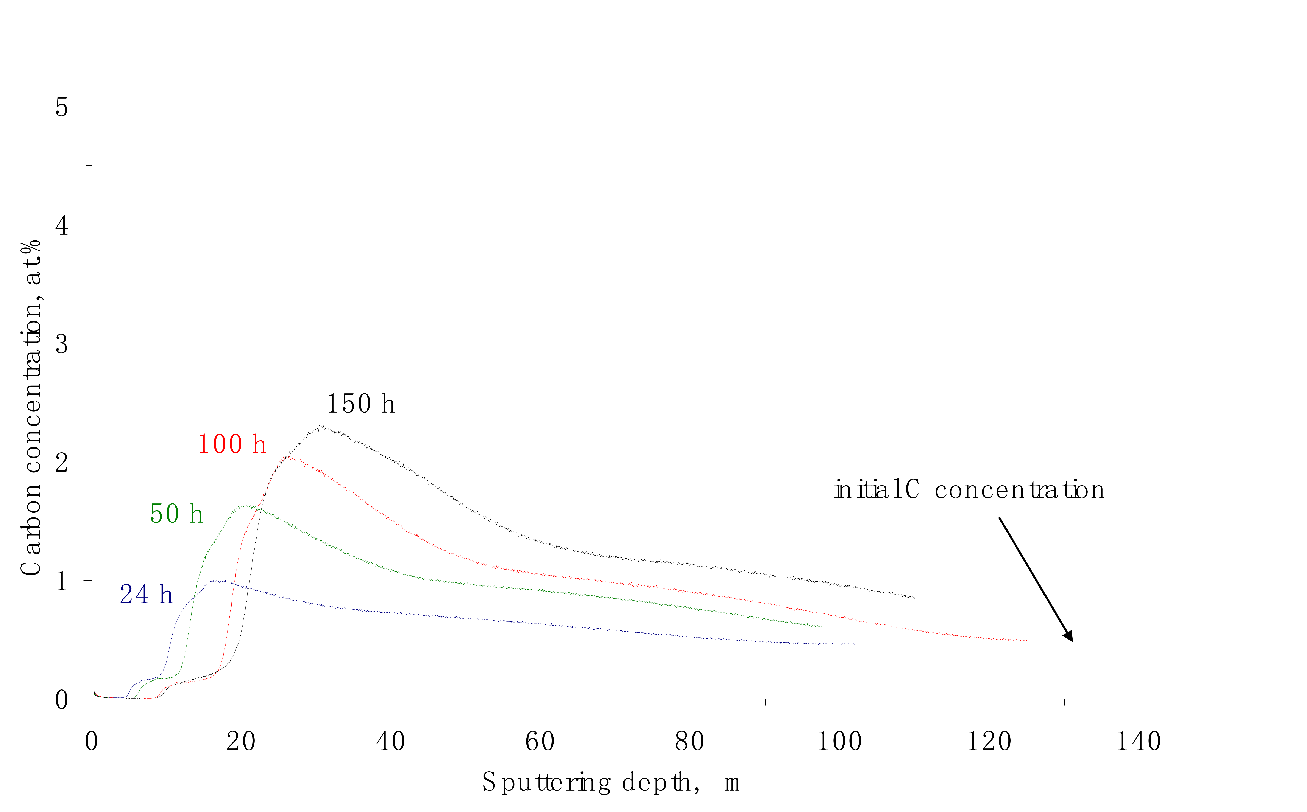
Carbon Distribution (GDOES)
P92, Ar-50%CO₂ for 150h, 550ºC
As t increases:
1.
2.

Slide 5
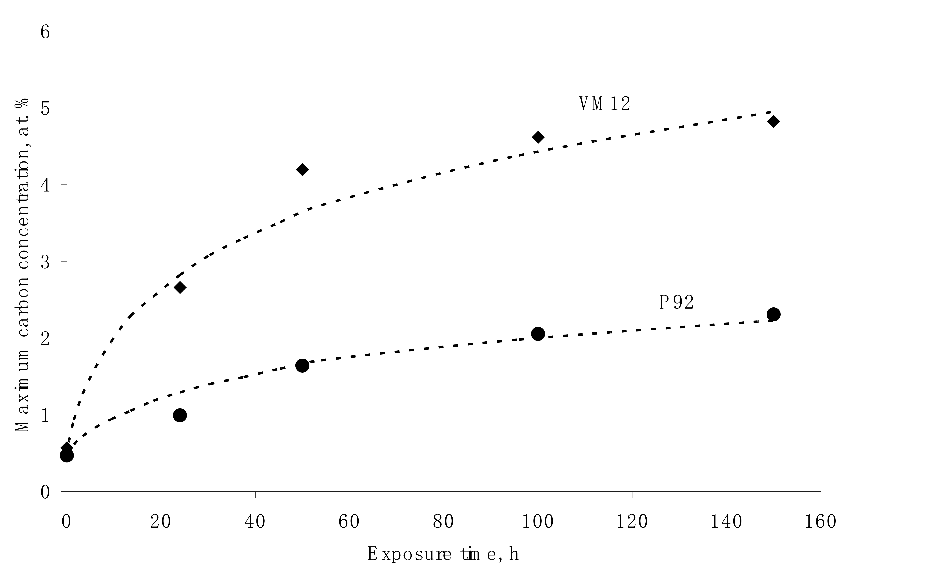
Boundary Value of C Concentration
P92 and VM12 at 550°C in Ar-50%CO₂

Slide 6
Oxide-Alloy Interface
Interface moves, because ..
Alloy carbon concentration increases

Slide 7
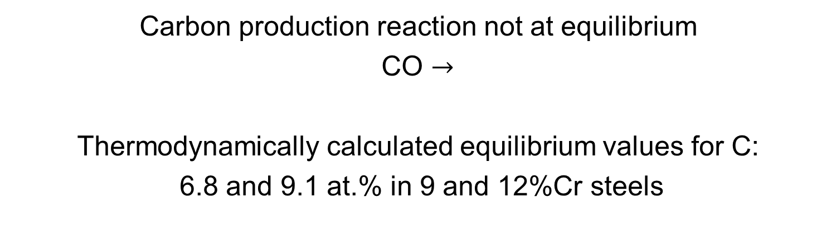
Non-equilibrium Boundary Condition

Slide 8
Boundary Value of C Concentration
Equilibrium:
9.1 at. %
Equilibrium:
6.8 at. %
P92 and VM12 at 550°C in Ar-50%CO₂

Slide 9

Non-equilibrium Boundary Condition
Gas
Alloy
Oxide scale

Slide 10
Non-equilibrium Boundary Condition
Alloy
Oxide scale

Slide 11
Non-equilibrium Boundary Condition
THREE PROCESSES
1.
2.
3.

Slide 12
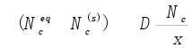
Carbon Injection at Oxide-Alloy Interface

Slide 13
Carbon Injection at Oxide-Alloy Interface
Carbon injection rate
Carbon removal rate

Slide 14
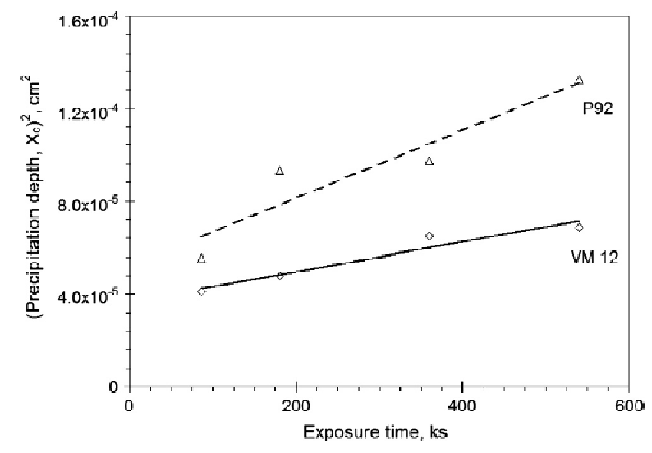
Carburisation Kinetics
Parabolic (steady-state) kinetics
BUT, non steady state boundary condition!

Slide 15
Non-equilibrium Boundary Condition
C diffusion via ferrite matrix, not the precipitates
Measured C concentration is for (matrix + precipitates)

Slide 16

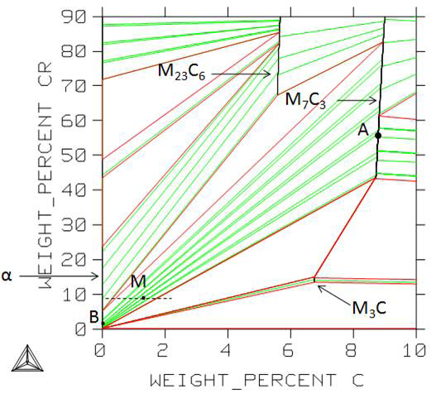
Assume local equilibrium
Use phase diagram
Apply lever rule

Slide 17
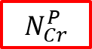
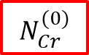
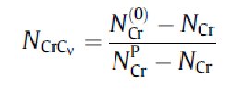

Assume local equilibrium
Use phase diagram
Apply lever rule

Slide 18
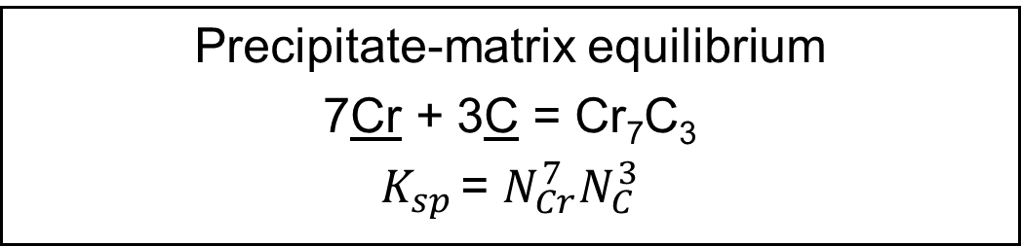
Precipitation of Cr₇C₃

Slide 19
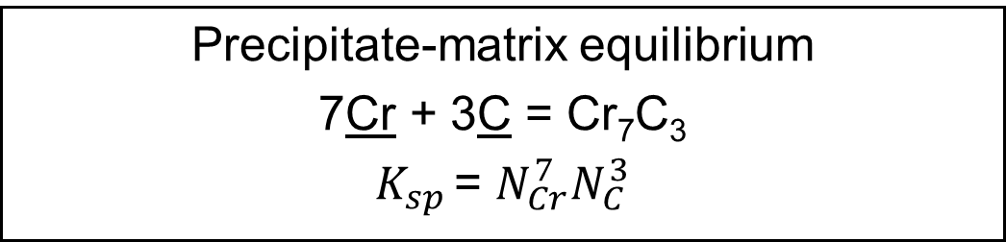
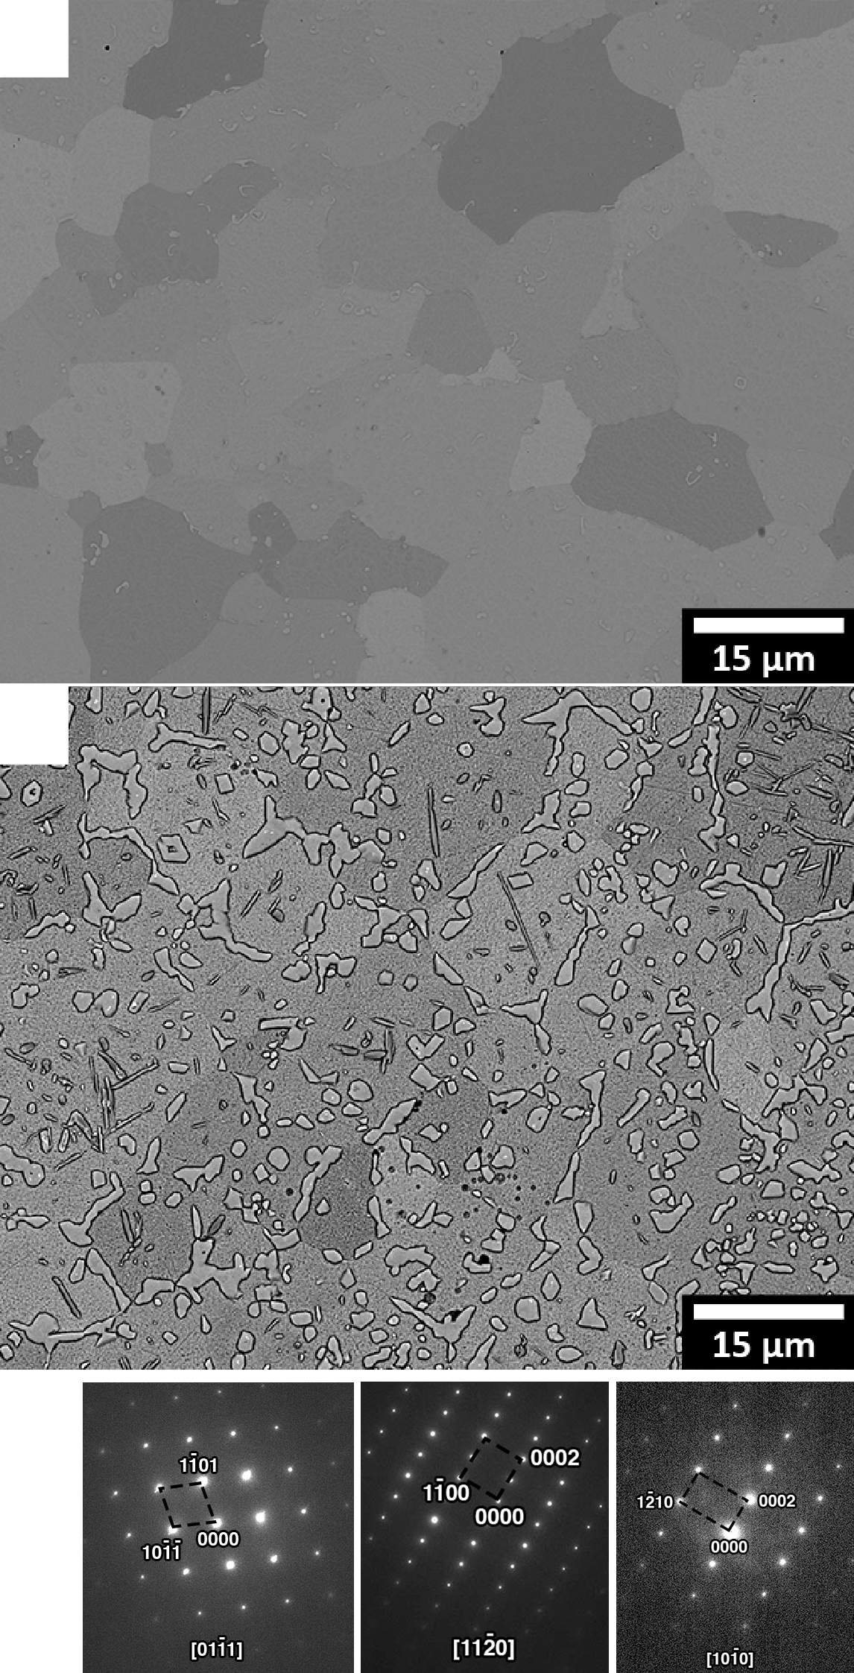
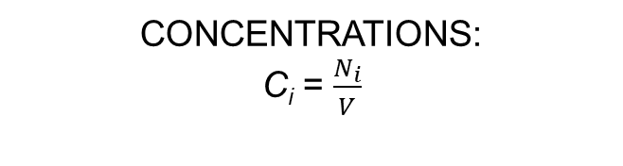
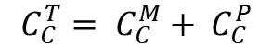
Precipitation of Cr₇C₃
(a)
(b)
(c)

Slide 20
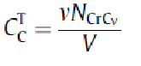
Precipitation of Cr₇C₃
(a)
(b)
(c)

Slide 21
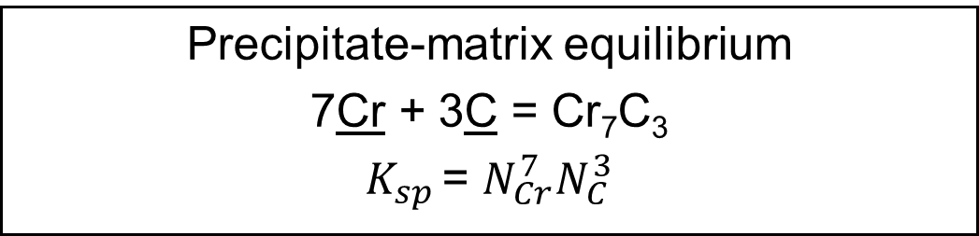
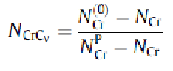
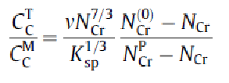
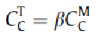
Precipitation of Cr₇C₃
EQUATIONS:

Slide 22
Precipitation of Cr₇C₃
EQUATIONS:
Total C increases a lot
BUT, C_{C} in ferrite changes little
EXPLAINS why carbon matrix diffusion
almost steady-state

Slide 23
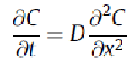
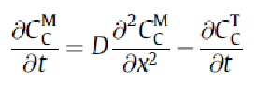
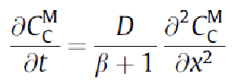
Solve Diffusion Equation
In matrix, conventionally,
Must modify to account for precipitation of C as carbide
Substitute

Slide 24
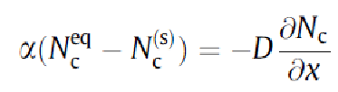

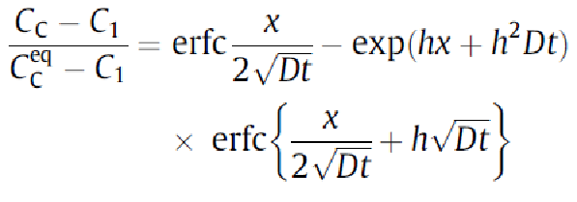
Solution

Slide 25
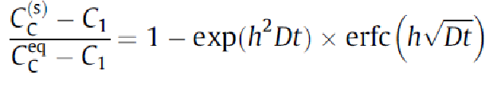
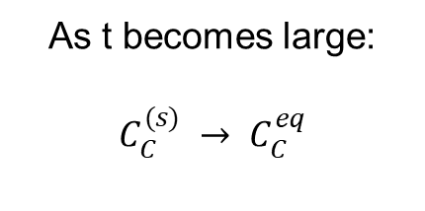
Test Solution at Surface
At surface, x = 0

Slide 26
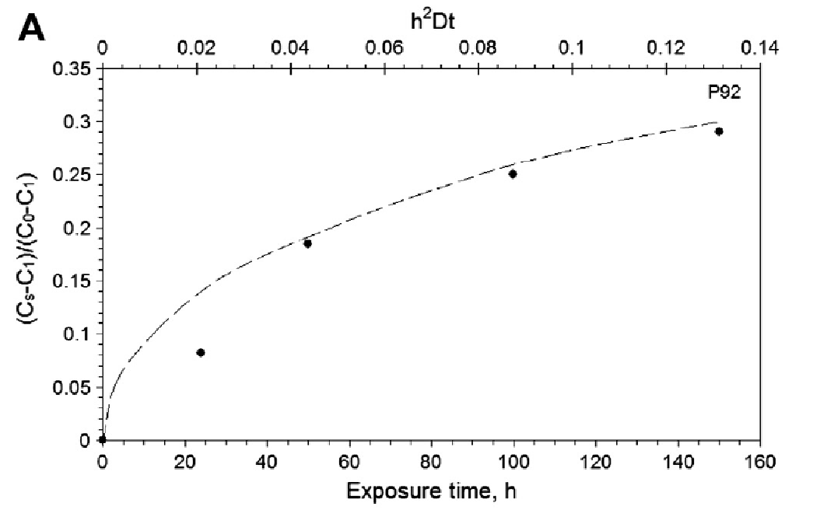
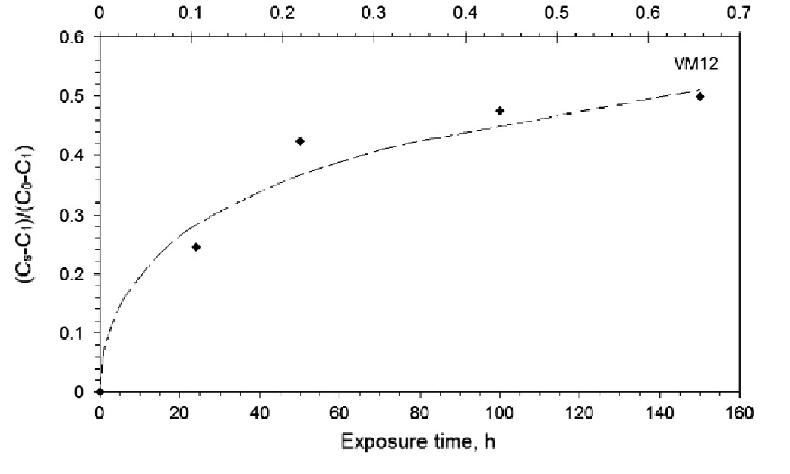
Apply to Lab Data
Prediction of increase in surface concentration good

Slide 27
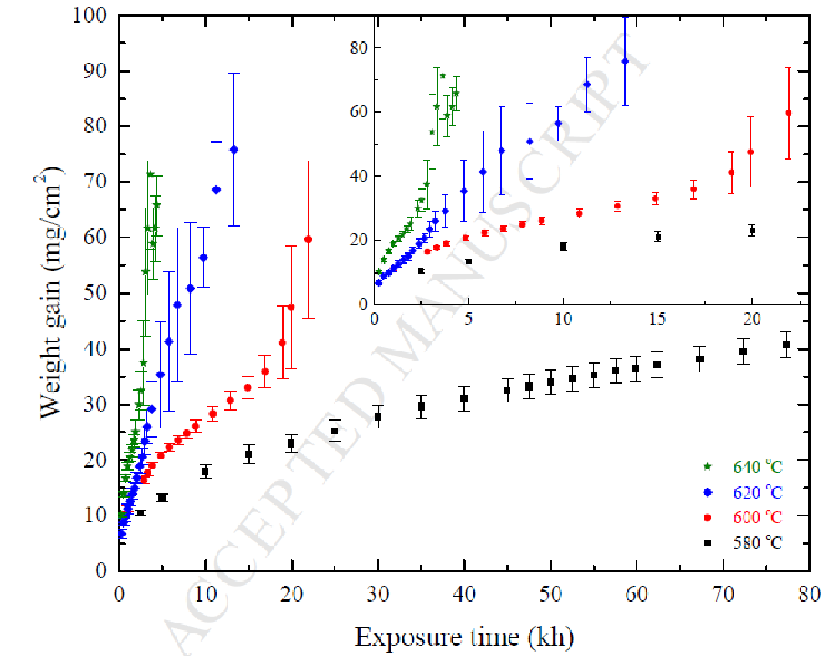
AGR Accelerated Corrosion Tests

Slide 28
AGR Accelerated Corrosion Tests
Maximum Operating Temperature
~ 540ºC

Slide 29
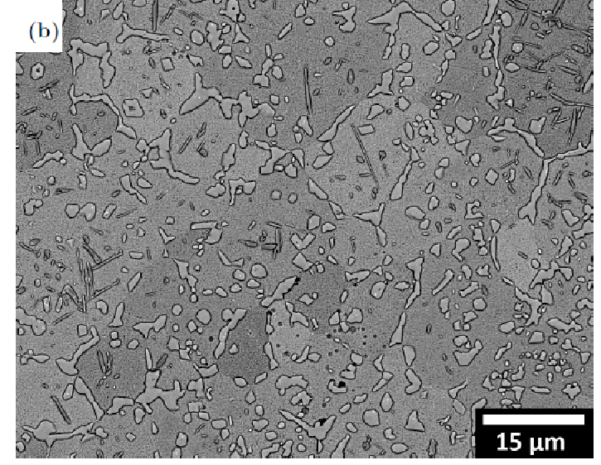
Internal Carburisation
Measured volume fraction of carbide as f(position in fin)

Slide 30
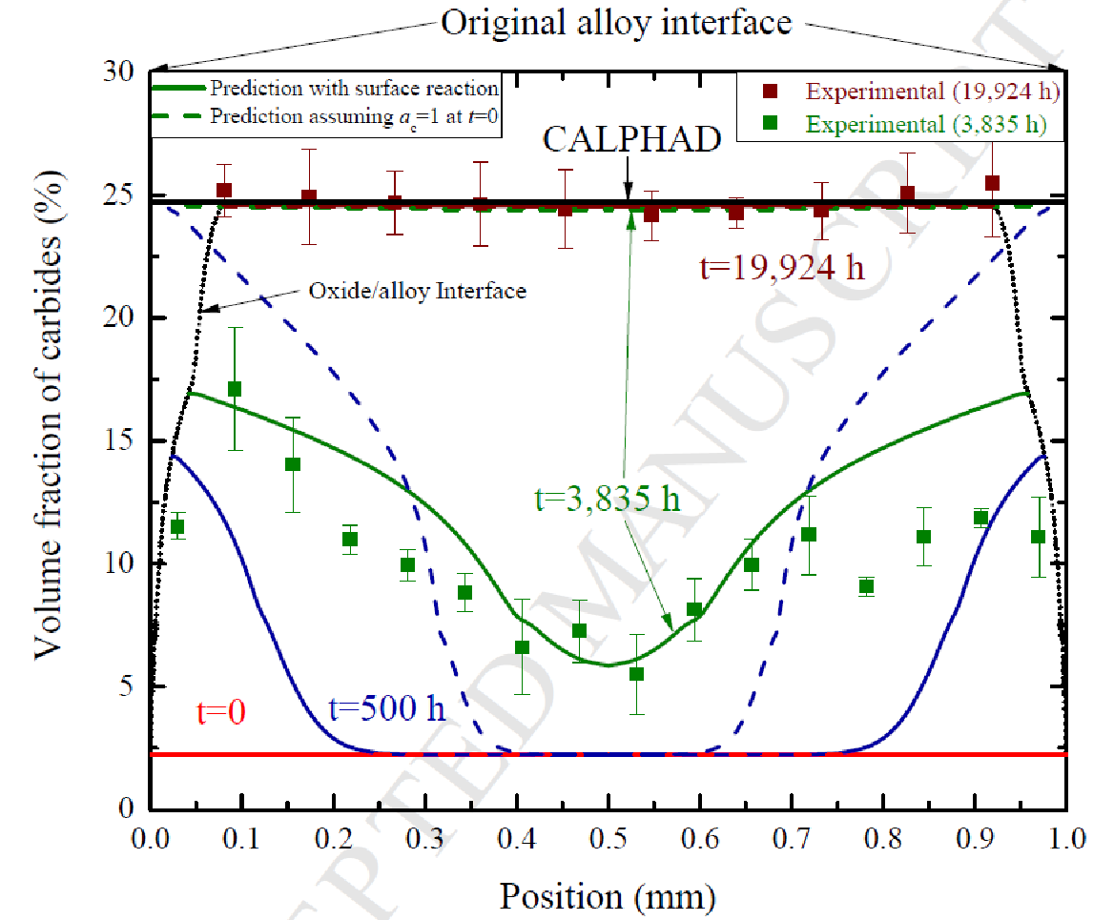
Carbide Profiles Across Fin

Slide 31
DICTRA fit to C Curves
Fit reasonably successful
Allows prediction of time to saturation of fin withC

Slide 32
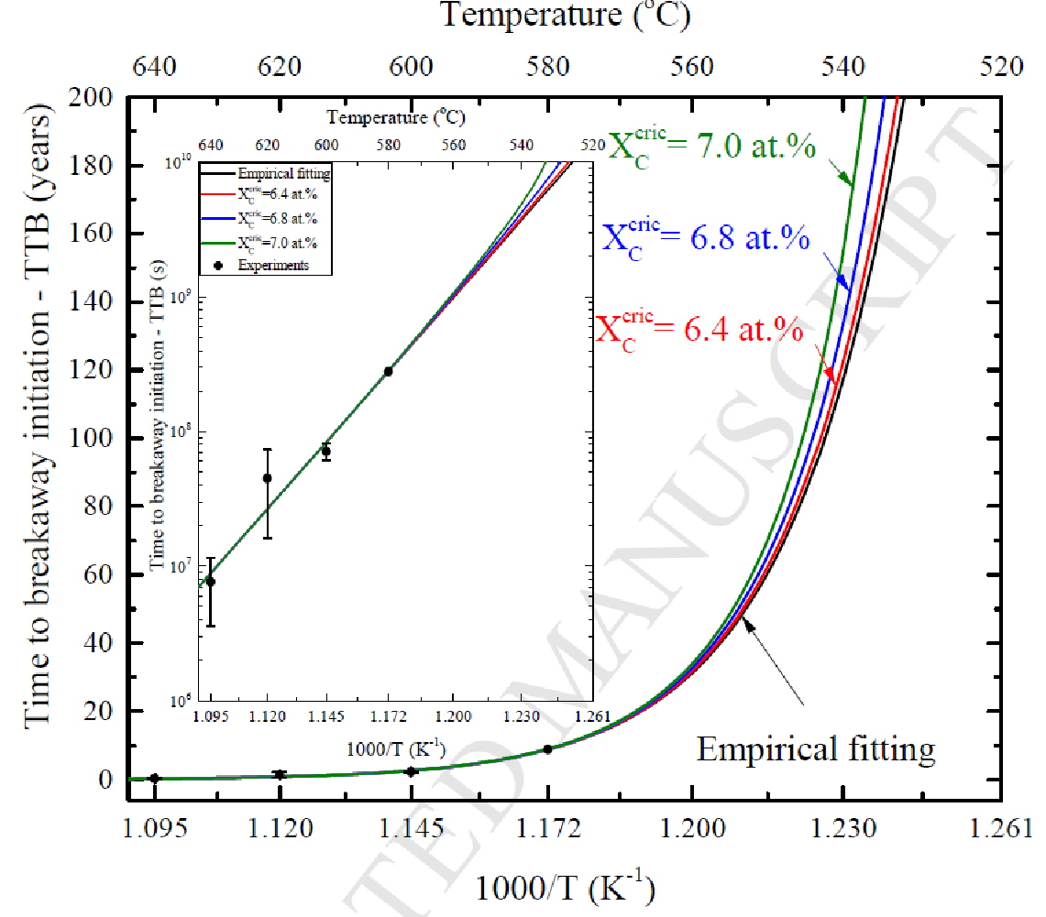
Predict Breakaway at C Saturation

Slide 33
SUMMARY
At low T, C very slow to equilibrate at oxide-steel surface
Surface concentration increases with time
Lab (short-term) data described using C diffusion model with injection rate boundary condition
Analytical solution possible for semi-infinite geometry
Not applicable to cooling fins on heat exchanger
Can model numerically – successfully fit C profiles
Lifetime prediction possible

